Slide 1
Native Modules

Slide 2
Objectives
Understand the Native modules
Native module setup
Creating a native module for Android and iOS

Slide 3
Native modules?

Slide 4
What is the Native module?
A native module is a set of JavaScript functions that are implemented natively for each platform (in our case is iOS and Android).
It is used in cases where native capabilities are needed, that react native doesn't have a corresponding module yet, or when the native performance is better.

Slide 5
Why do we need Native modules?
Sometimes a React Native app needs to access a native platform API that is not available by default in JavaScript, for example the native APIs to access Apple or Google Play.
Maybe you want to reuse some existing Objective-C, Swift, Java or C++ libraries without having to reimplement it in JavaScript, or write some high performance, multi-threaded code for things like image processing.

Slide 6
Why do we need Native modules?
The Native Module system exposes instances of Java/Objective-C/C++ (native) classes to JavaScript (JS) as JS objects, thereby allowing you to execute arbitrary native code from within JS.
While we don't expect this feature to be part of the usual development process, it is essential that it exists. If React Native doesn't export a native API that your JS app needs you should be able to export it yourself!

Slide 7
Native module setup
There are two ways to write a native module for your React Native application:
1. Directly within your React Native application’s iOS/Android projects.
2. As a NPM package that can be installed as a dependency by your/other React Native applications.

Slide 8
Creating a native module

Slide 9
Creating a native module
We are going to build a module that stores the user's preferred app theme - either dark, light, or system. We'll use UserDefaults on iOS and SharedPreferences on Android. It is possible to implement web support using localStorage

Slide 10
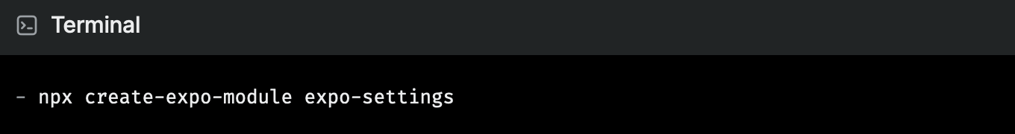
1. Initialize a new module
First, we'll create a new module. On this demo we will use the name expo-settings/ExpoSettings. You can name it whatever you like, just adjust the instructions accordingly:

Slide 11
2. Set up our workspace
Now let's clean up the default module a little bit so we have more of a clean slate and delete the view module that we won't use in this guide.
> cd expo-settings
> rm ios/ExpoSettingsView.swift
> rm android/src/main/java/expo/modules/settings/ExpoSettingsView.kt
> rm src/ExpoSettingsView.tsx src/ExpoSettingsView.web.tsx src/ExpoSettingsModule.web.ts src/ExpoSettings.types.ts

Slide 12
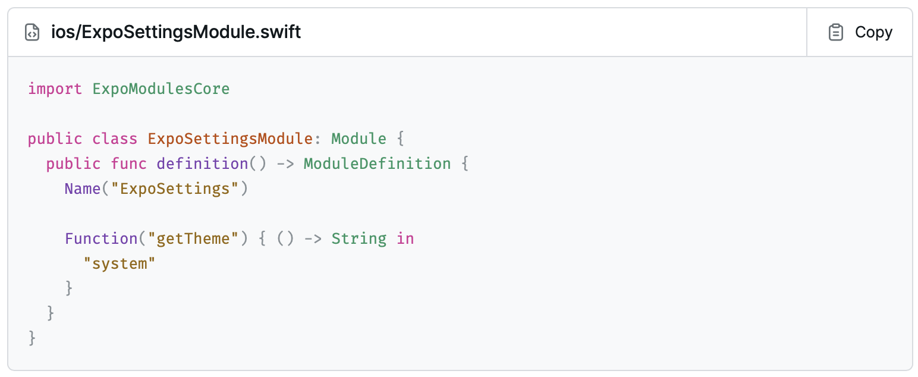
2. Set up our workspace (contd.)
Find the following files and replace them with the provided minimal boilerplate:

Slide 13
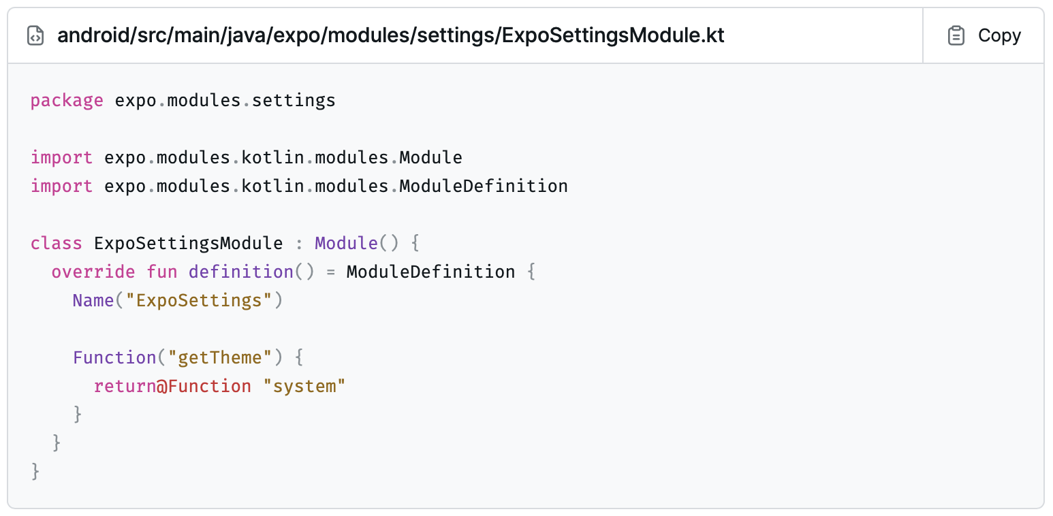
2. Set up our workspace (contd.)

Slide 14
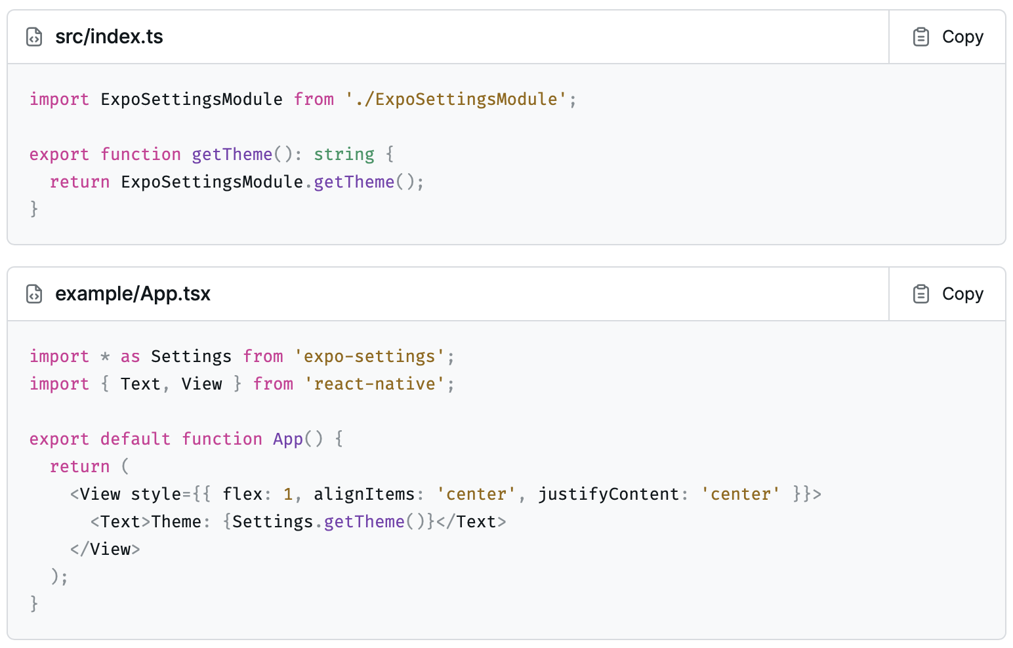
2. Set up our workspace (contd.)

Slide 15
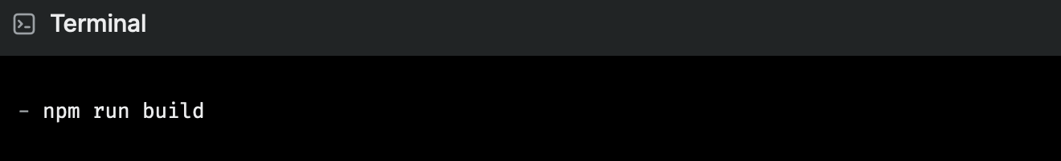
3. Run the example project
Now let's run the example project to make sure everything is working. We'll need to start the TypeScript compiler to watch for changes and rebuild the module JavaScript, and separately in another terminal window we'll compile and run the example app.

Slide 16
3. Run the example project (contd.)
> cd example
> npx expo run:ios
> npx expo run:android
We should now see the text "Theme: system" in the center of the screen when we launch the example app. The value "system" is the result of synchronously calling the getTheme() function in the native module. We'll change this value in the next step.

Slide 17
4. Get, set, and persist the theme preference value
iOS native module
To read the value on iOS, we can look for a UserDefaults string under the key "theme", and fall back to "system" if there isn't any.
To set the value, we can use UserDefaults's set(_:forKey:) method. We'll make our setTheme function accept a value of type String.

Slide 18
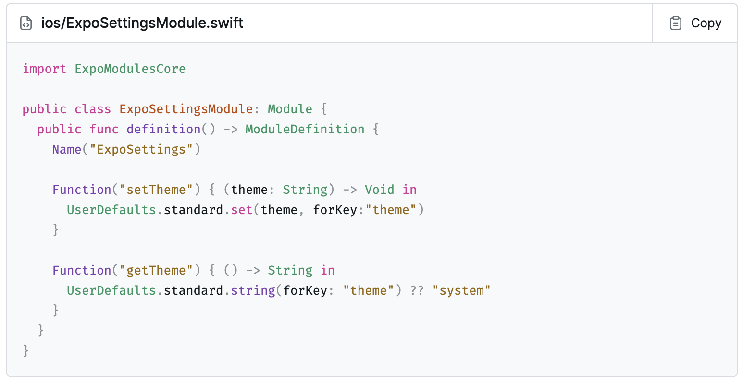
4. Get, set, and persist the theme preference value

Slide 19
4. Get, set, and persist the theme preference value
Android native module
To read the value, we can look for a SharedPreferences string under the key "theme", and fall back to "system" if there isn't any. We can get the SharedPreferences instance from the reactContext (a React Native ContextWrapper) using getSharedPreferences().
To set the value, we can use SharedPreferences's edit() method to get an Editor instance, and then use putString() to set the value. We'll make our setTheme function accept a value of type String.

Slide 20
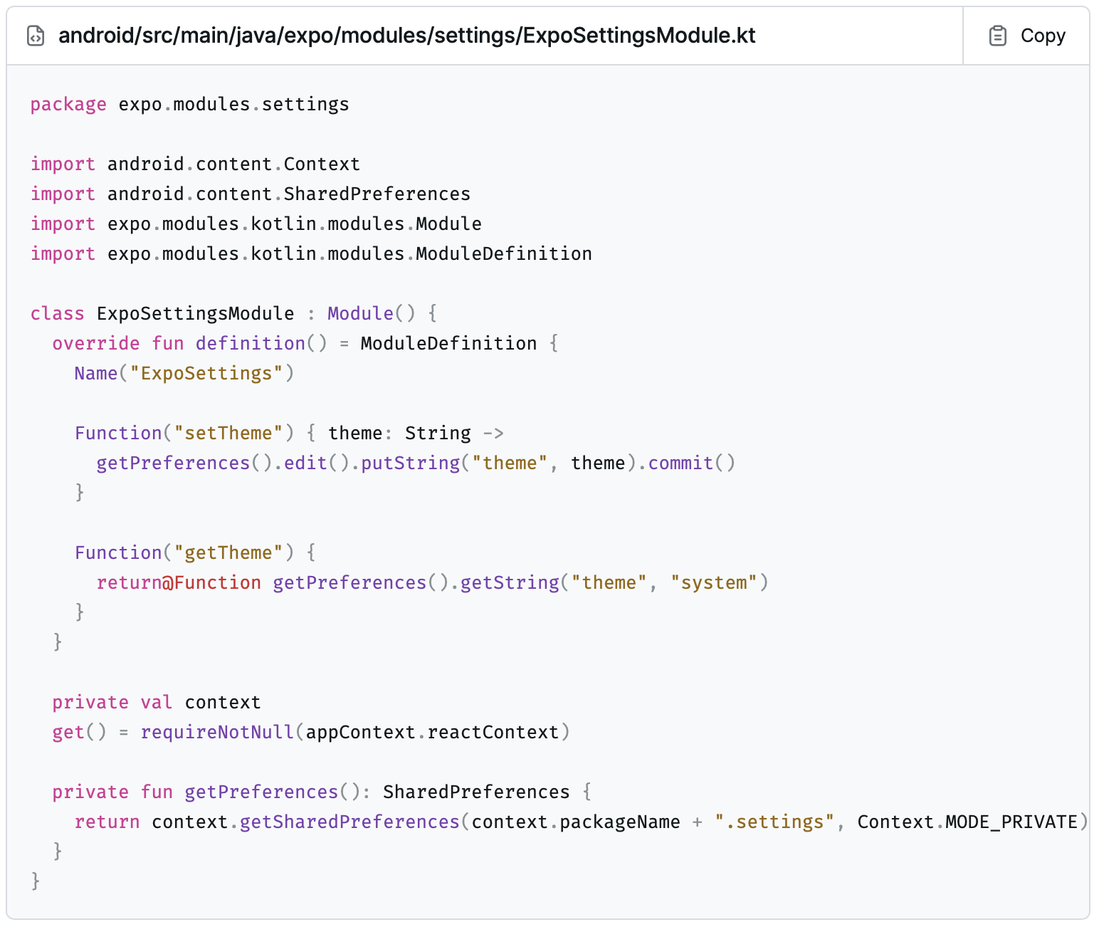
4. Get, set, and persist the theme preference value

Slide 21
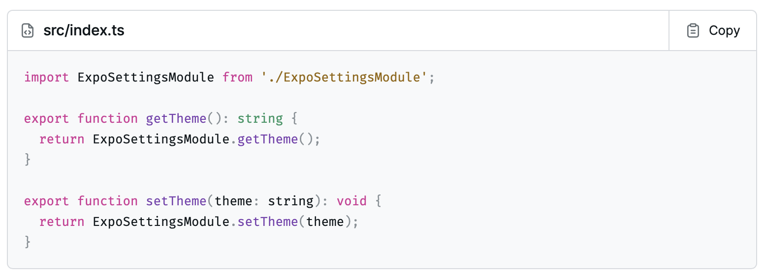
4. Get, set, and persist the theme preference value
TypeScript module
Now we can call our native modules from TypeScript.

Slide 22
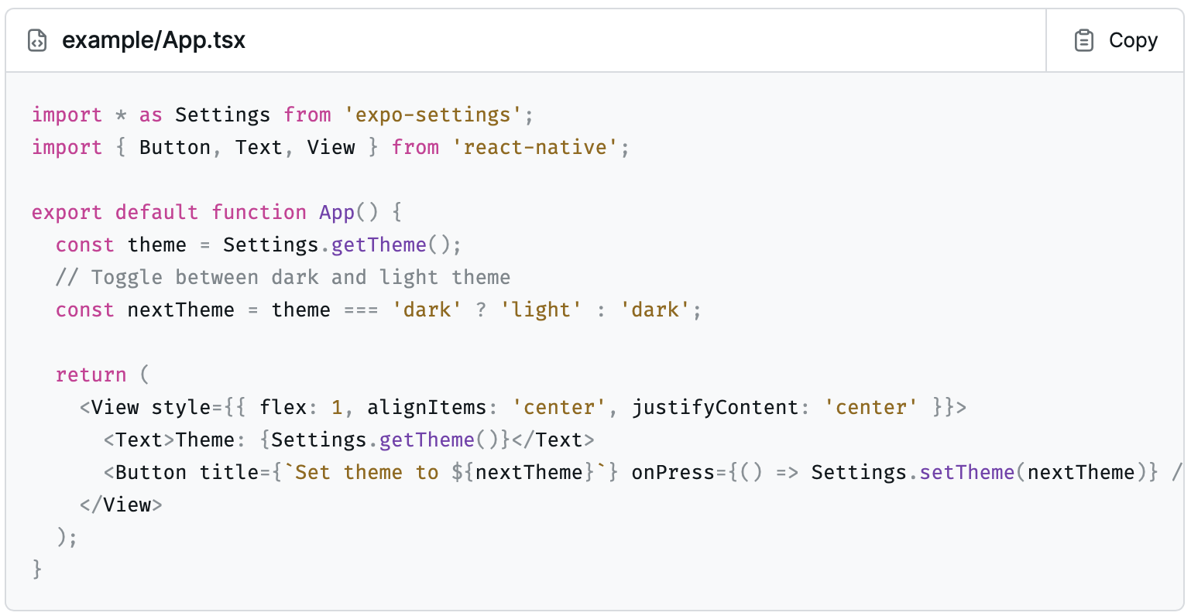
4. Get, set, and persist the theme preference value
Example app
We can now use the Settings API in our example app.

Slide 23
4. Get, set, and persist the theme preference value
When we re-build and run the app, we'll see the "system" them is still set. When we press the button, nothing happens. When you reload the app, you'll see the theme has changed. This is because we're never fetching the new theme value and re-rendering the app. We'll fix this in the next step.

Slide 24
5. Emit change events for the theme value
We can ensure that developers using our API can react to changes in the theme value by emitting a change event when the value changes.
We'll use the Events definition component to describe events that our module can emit, sendEvent to emit the event from native, and the EventEmitter API to subscribe to events in JavaScript. Our event payload will be { theme: string }.

Slide 25
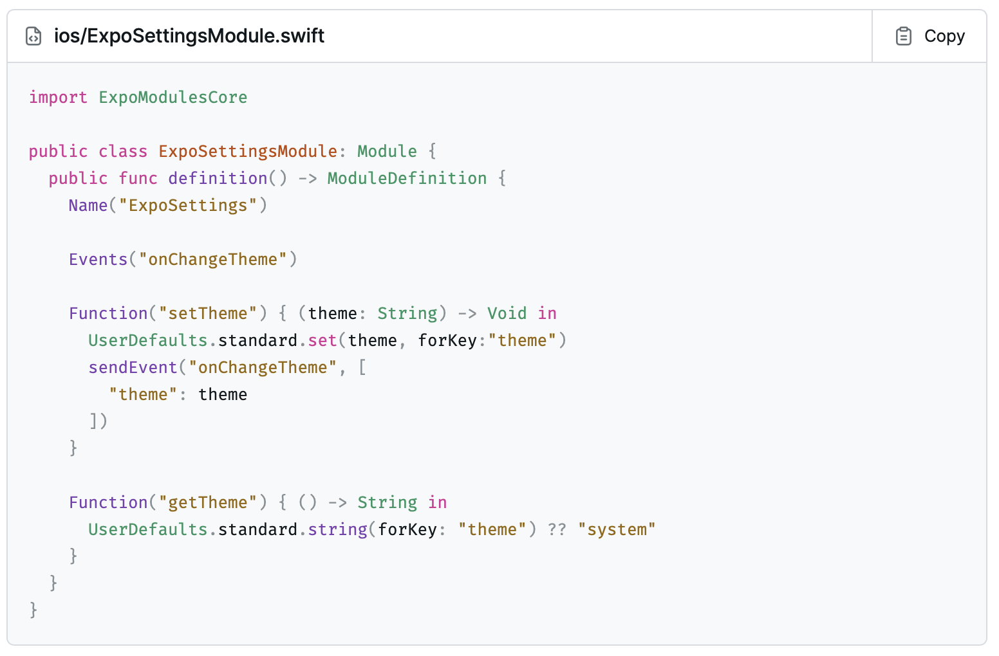
5. Emit change events for the theme value
iOS native module:

Slide 26
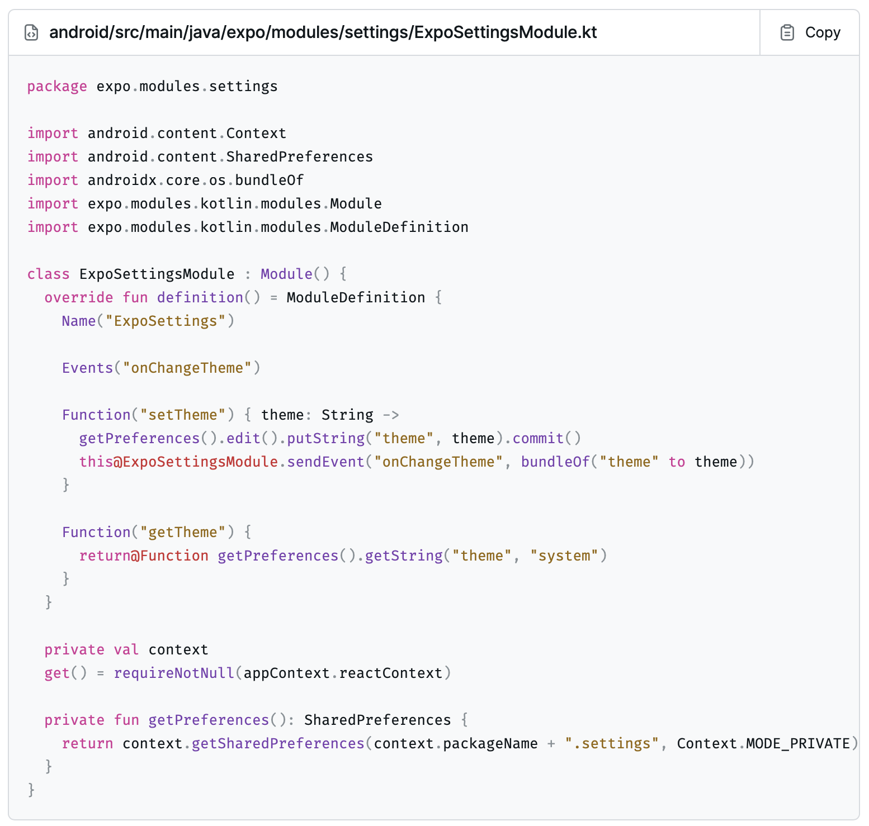
5. Emit change events for the theme value
Android native module:

Slide 27
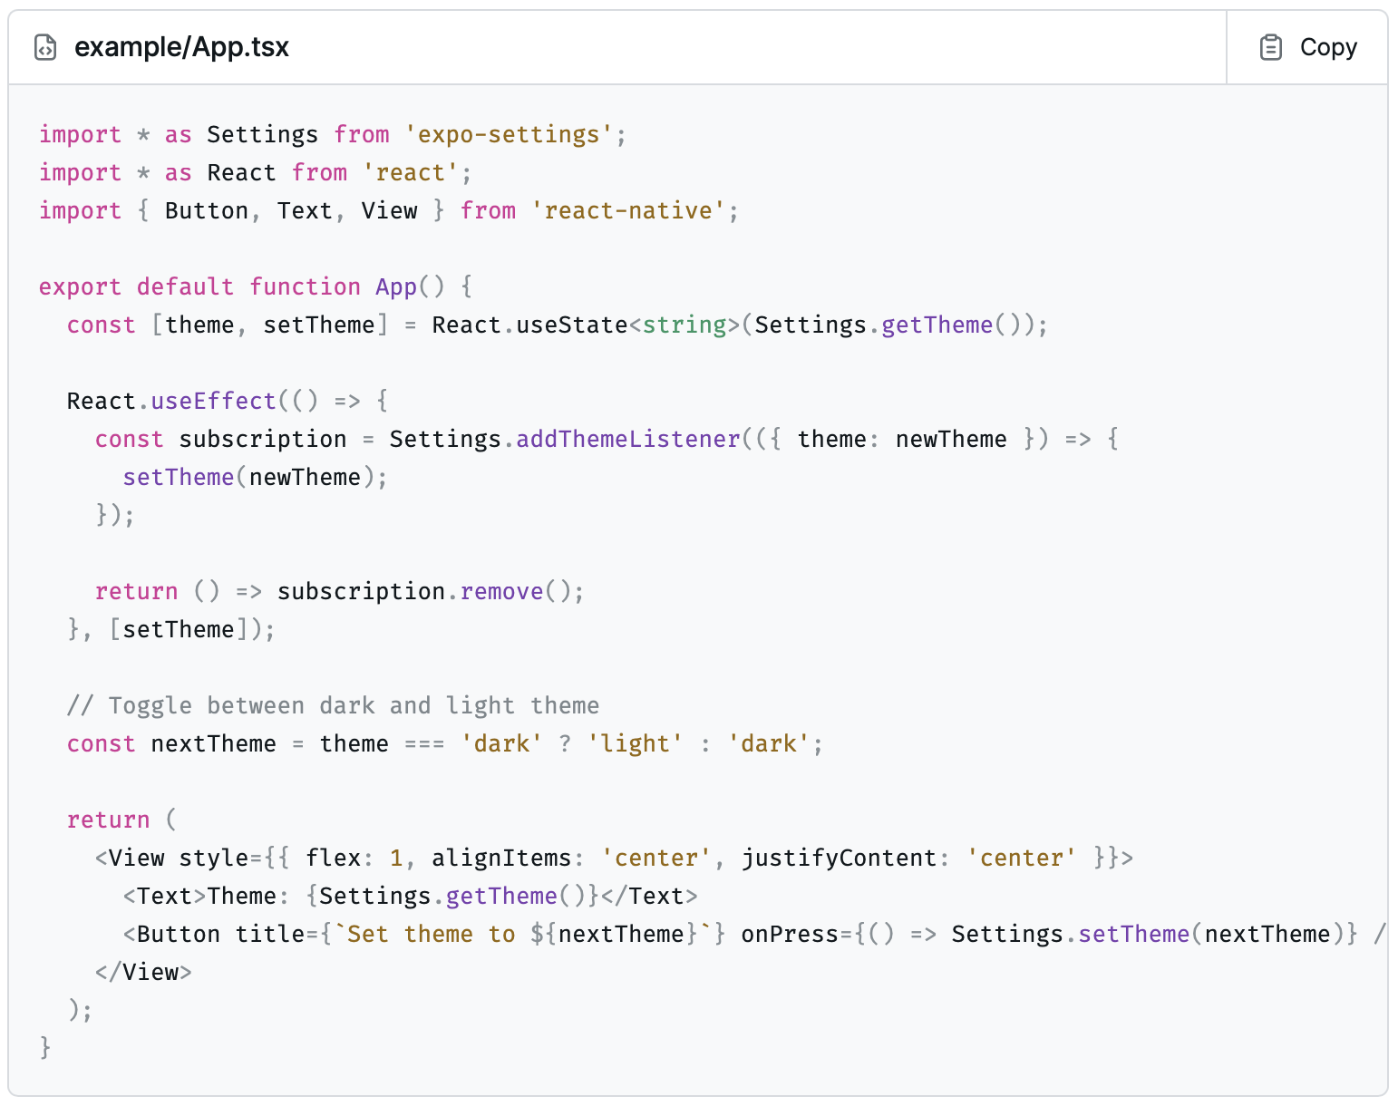
5. Emit change events for the theme value
Example app

Slide 28
Summary
In this session, we learned the following:
Understand what is the Native Modules
Understand setup Native module on Android and iOS applications
Demo creating a native module for Android and iOS

